Slide 1
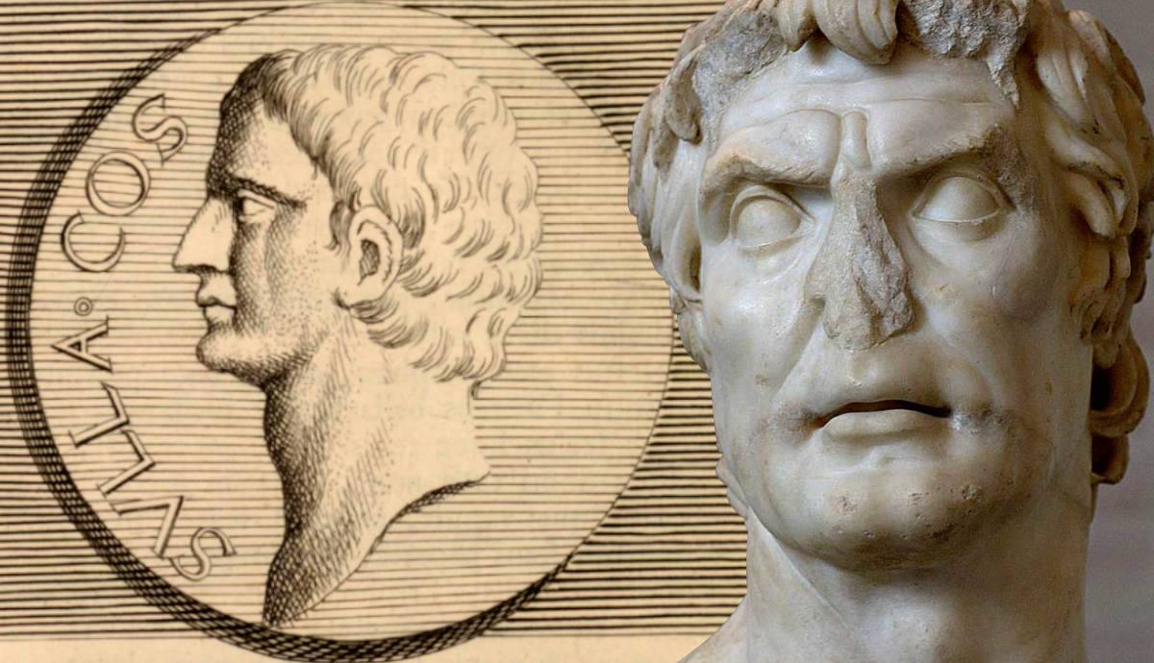
Death and Legacy
GOAL/S: Evaluate Sulla’s legacy
Week 3, Lesson 3

Slide 2
Sulla’s Retirement and Death
After three years as the most powerful person in Rome, Sulla retired from public life in 79 BCE.
He withdrew to his country estate near Puteoli (modern-day Pozzuoli) in Naples. There, he wrote his memoirs and lived out the rest of his days in relative tranquility.
He died in 78 BCE at the age of 60, apparently while yelling orders to have one more of his enemies executed.
It was said that when he had died, he had been so reviled by the people of Rome that no one even bothered to attend his funeral.
And so, Lucius Cornelius Sulla, the Roman general and dictator, was laid to rest in obscurity.

Slide 3
ACTIVITY – Legacy and Impacts
Create a mindmap of the legacy and impacts of Sulla

Slide 4
Legacy and Impacts

Slide 5
TEACHER ONLY – Short Term and Long Term Impacts
Short-Term Impacts:
Civil War Victory: Sulla emerged as the victor in the first full-scale civil war in Roman history (88–82 BCE). His victory over his rival, Gaius Marius, allowed him to consolidate power and establish himself as a dominant force.
Dictatorship: After his victory, Sulla declared himself dictator (82–79 BCE). As dictator, he wielded immense authority and implemented significant reforms.
Constitutional Reforms: Sulla carried out notable constitutional reforms aimed at strengthening the Roman Republic. These reforms included changes to the Senate’s composition, the powers of magistrates, and the legal system
Proscriptions: Unfortunately, Sulla’s pursuit of power was ruthless. He conducted proscriptions, during which he targeted and executed political opponents. These actions left a dark mark on Roman history
Long-Term Impacts:
Military Leaders Seizing Power: Sulla’s actions set a precedent for military leaders to seize power in Rome. This pattern continued, contributing to the eventual downfall of the Republic.
Influence on Roman Politics: Although Sulla’s reforms did not last long, his legacy significantly influenced Roman politics until the Republic’s collapse in 27 BCE. His emphasis on senatorial power and constitutional changes left a lasting impact

Slide 6
TEACHER ONLY – Legacy
Constitutional Reforms:
Sulla was an Optimate who rose to power during a tumultuous period in Rome. As dictator (82–79 BCE), he implemented several constitutional reforms to revitalize and restore senatorial power.
His reforms aimed to strengthen the Roman Republic, but they did not endure for long. Nevertheless, they had a lasting impact on Roman politics during the final years of the Republic until its fall in 27 BCE¹.
Increased Senate Power:
Under Sulla’s leadership, the Senate gained more authority. His reforms shifted the balance of power toward the Senate, emphasizing its role in decision-making.
By bolstering senatorial influence, Sulla aimed to stabilize the Republic and prevent further internal strife².
Precedent for Military Leaders:
Sulla’s actions set a precedent for military leaders to seize power in Rome. His rise to dictatorship demonstrated that a general could effectively take control of the state.
Unfortunately, this pattern continued, leading to further instability and contributing to the eventual downfall of the Roman Republic

Slide 7
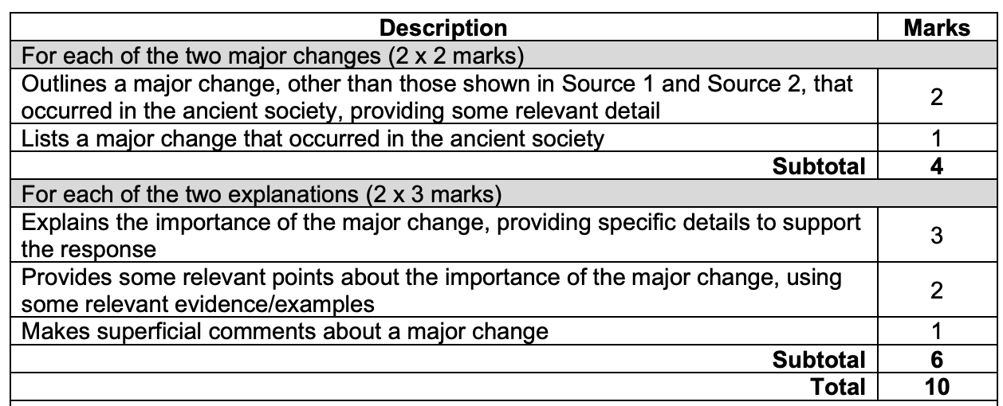
PRACTICE EST QUESTION
Outline two major changes that occurred in this society.
Explain the importance of these changes.

